Slide 1
TOPIC 1: THE WORLD AROUND 1600
What was the world like around 1600?
The slides for this topic include:
● colour pictures to accompany the notes
● a start to a mindmap on this topic
● an example of a completed mindmap on this topic
● colour pictures to accompany the source-based
questions.
www.theanswer.co.za

Slide 2
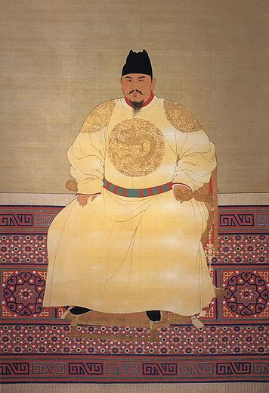
Source: Hardouin
The Hongwu Emperor
www.theanswer.co.za
See page 4

Slide 3
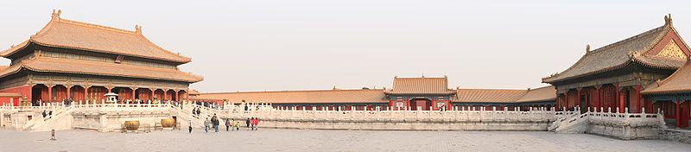
Source: LuxTonnerre
Inside Beijing's Forbidden City
www.theanswer.co.za
See page 4

Slide 4
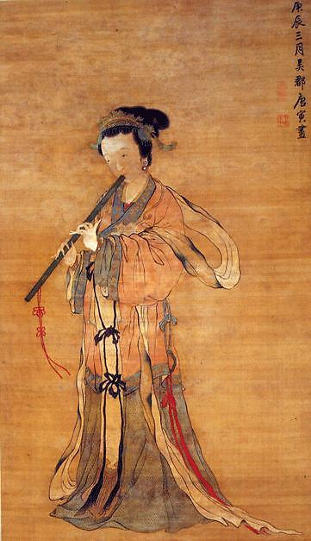
Source: Berthe
A painting by Tang Yin
www.theanswer.co.za
See page 5

Slide 5
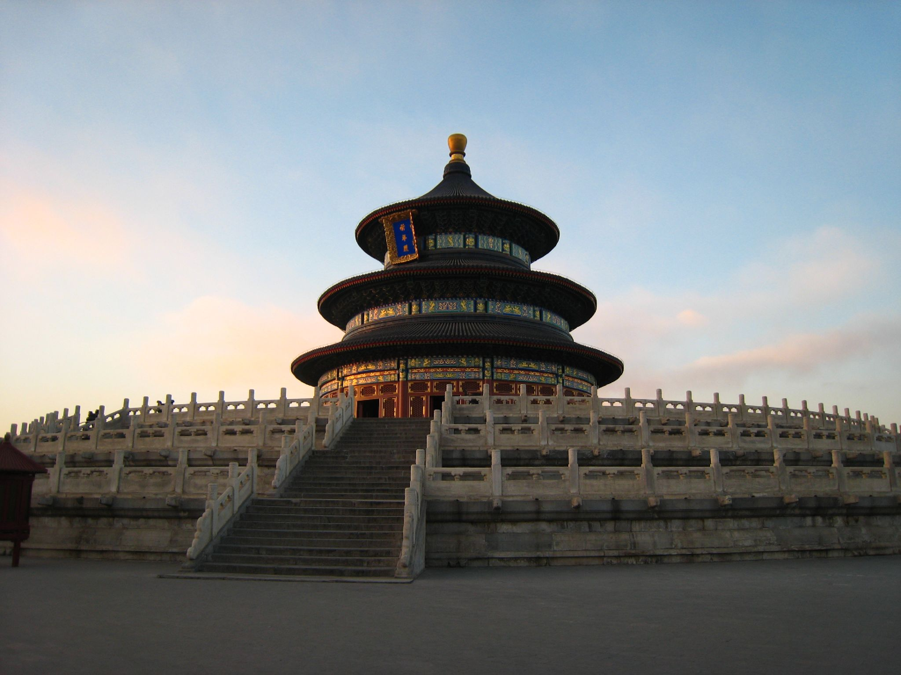
Source: star5112
A Taoist temple in Beijing
www.theanswer.co.za
See page 5

Slide 6
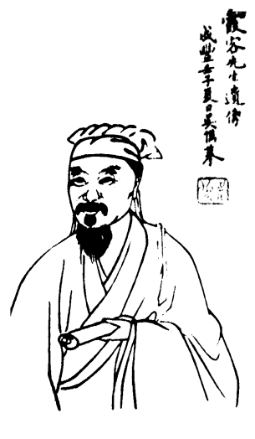
Source: Mountain / Lushan Museum
The geographer Xu Xiake
www.theanswer.co.za
See page 5

Slide 7
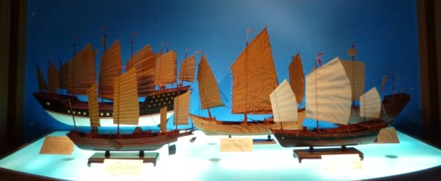
Source: Vmenkov
Modern models of the junks (ships) in Zheng He's fleet that show the
sophisticated system of sails that allowed these ships to sail into the wind,
and made them more resistant to tearing. The smaller junks were flat-bottomed
while the large treasure ships had a keel for extra stability.
www.theanswer.co.za
See page 6

Slide 8
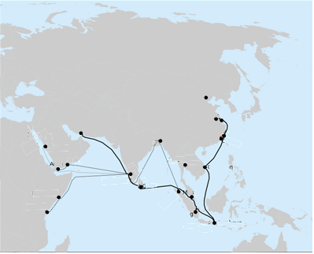
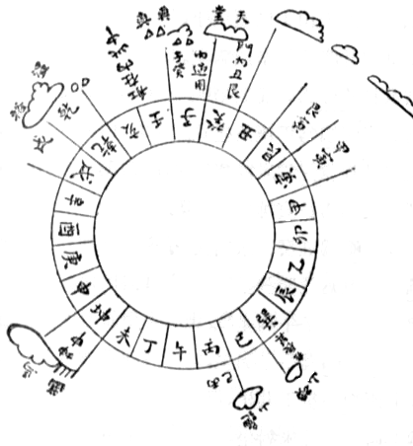
Beijing
Source: Gisling
Changshu
Hormuz
Nanjing
Chittagong
Fuzhou
Jeddah
Quanzhou
Aden
Mukalla
Ayatthaya
Calicut
Qui Nhon
Galle
A Ming Dynasty
diagram of a 24-point
marine compass
Mogadishu
Malacca
Lhokseumawe
Mombasa
Palembang
Surabaya
Zheng He's voyages
www.theanswer.co.za
See page 6

Slide 9
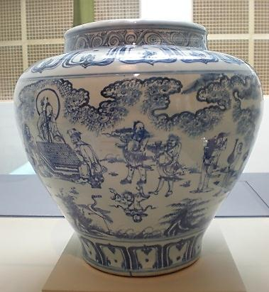
Source: BrokenSphere
A blue and white Ming vase showing scholars on the way to a gathering
www.theanswer.co.za
See page 7

Slide 10
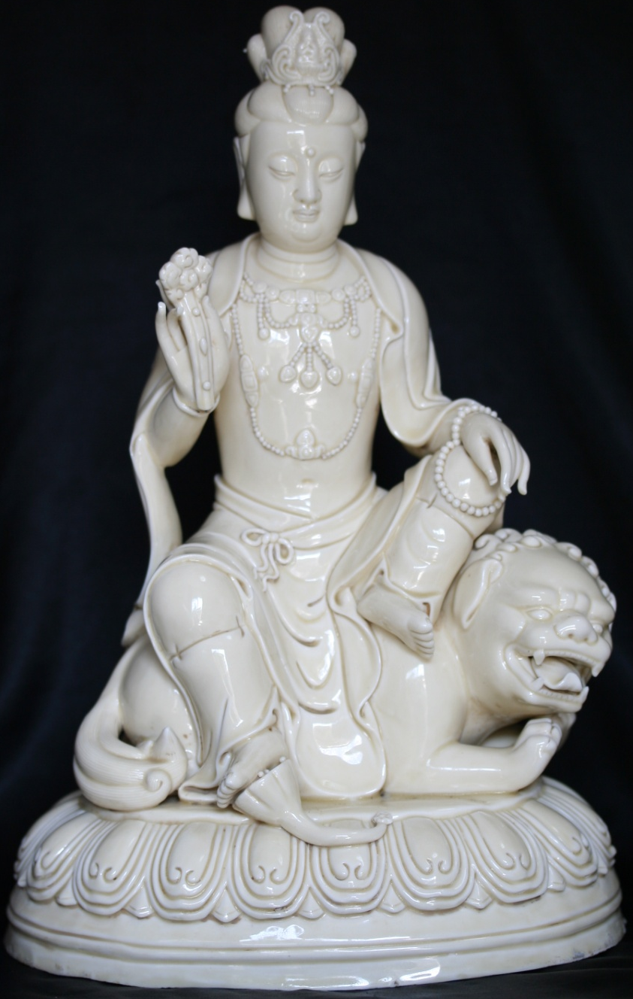
Source: Iwanafish
A Buddhist ceramic statue by He Chaozong
www.theanswer.co.za
See page 7

Slide 11
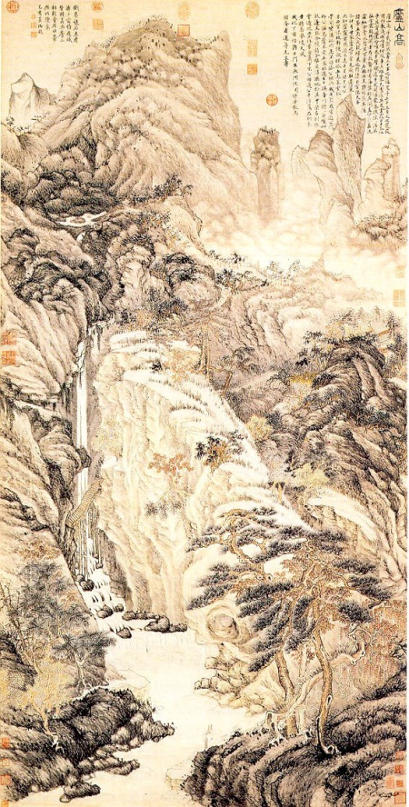
Source: Wiseworm Shizhou
Lofty Mountain by Shen Zhou
www.theanswer.co.za
See page 7

Slide 12
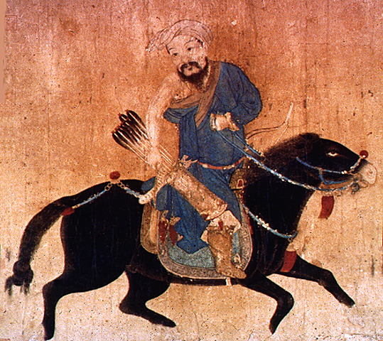
A Ming painting of a Mongol archer
www.theanswer.co.za
See page 8

Slide 13
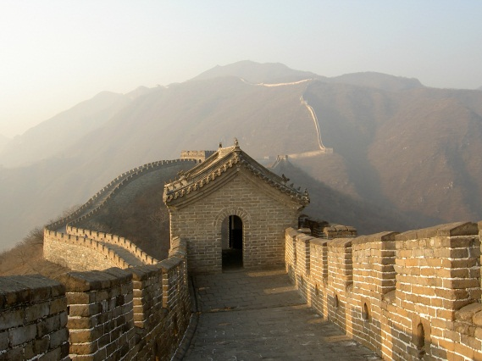
Source: Ofol
A section of the Great Wall of China
www.theanswer.co.za
See page 8

Slide 14
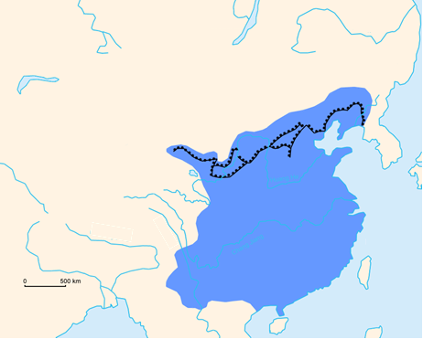
Mongols
Manchus
The Great Wall of China
Yellow
Sea
Source: Like tears in rain
MING EMPIRE
East China Sea
Tibet
South China
Sea
Ming China and the Great Wall of China
www.theanswer.co.za
See page 8

Slide 15
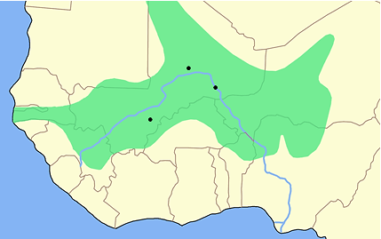
Timbuktu
Gao
SONGHAI EMPIRE
Source: Astrokey44
Djenné
Niger River
The Songhai Empire around 1500
www.theanswer.co.za
See page 9

Slide 16
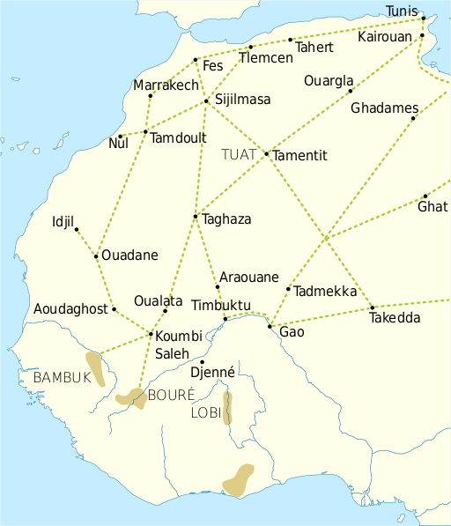

Walata
Source: Aa77zz
Trade routes of the Western Sahara 10001500
www.theanswer.co.za
See page 10

Slide 17
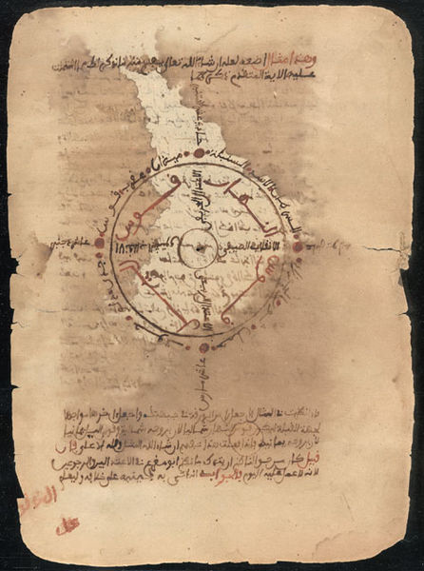
Source: Olybrius
A manuscript by Nasir al-Din Abu al-Abbas Ahmad ibn al-Hajj al-Amin al-Tawathi al-Ghalawi
www.theanswer.co.za
See page 11

Slide 18
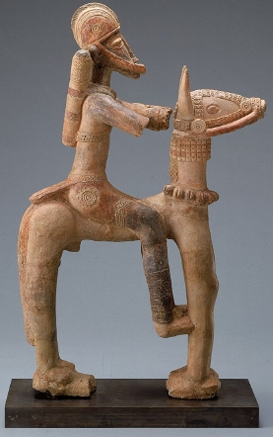
Source: Franko Khoury
This terracotta statuette from Djenné would have been produced
either under the Mali Empire or the Songhai Empire.
www.theanswer.co.za
See page 11

Slide 19
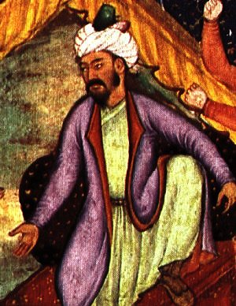
Source: http://www.kamat.com/kalranga/muslim/2349.htm
Zahir ud din Muhammad Babur
www.theanswer.co.za
See page 11

Slide 20
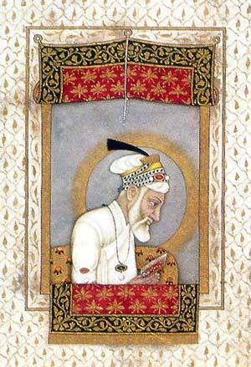
Source: www.paradoxplace.com
Emperor Aurangzeb Alamgir reading the Koran
www.theanswer.co.za
See page 11

Slide 21
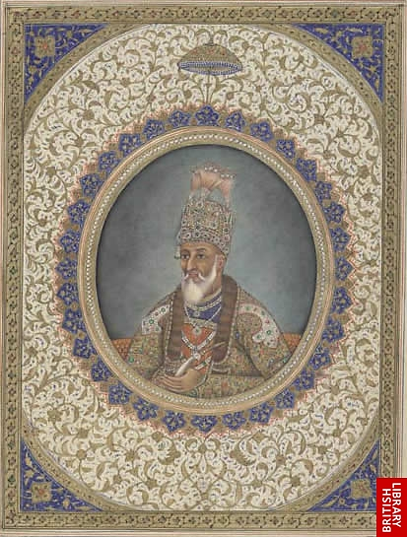
Bahadur Shah II
www.theanswer.co.za
See page 11

Slide 22
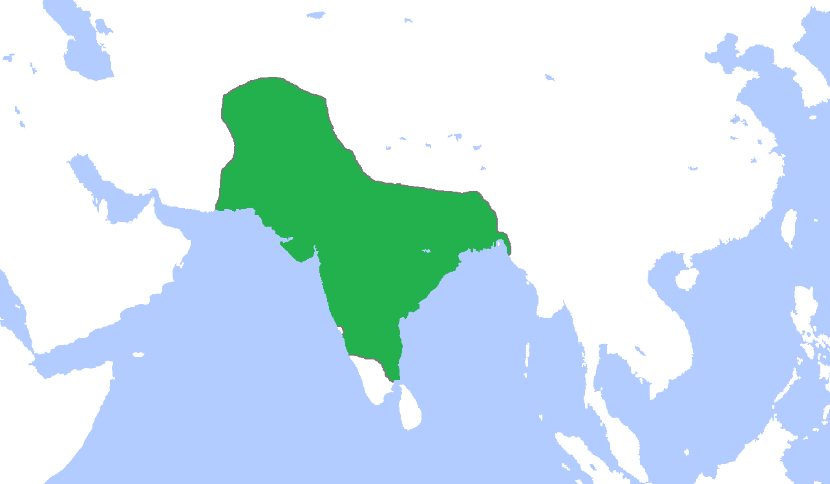
Fergana
Samarkand
Silk Road
Bactra
Khyber Pass
Kabul
Peshawar
China
Savvid
Empire
Hindu Kush Mountains
Tibet
Lahore
Himalayan Mountains
Kandahar
Source: Gabagool
Muzaffargarh
Panipat
Delhi
Overland Spice Route
Fatehpur Sikri
Allahabad
Agra
Buxar
Palashi
Sea Spice Route
MUGHAL
EMPIRE
Dhaka
Khambat
Calcutta
Surat
Bombay (Mumbai)
Fort Raigad
Khadki
Bay of Bengal
Arabian Sea
Goa
Madras
Mangalore
Pondicherry
Calicut
The Mughal Empire circa 1700
www.theanswer.co.za
See page 13

Slide 23
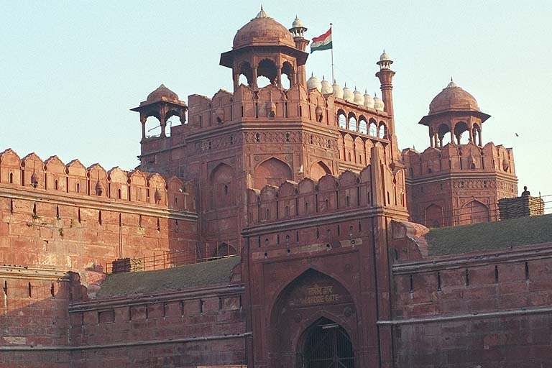
Source: Petersen
The Red Fort in Delhi was constructed as the residence
of the Mughal rulers by Emperor Shah Jahan.
www.theanswer.co.za
See page 13

Slide 24
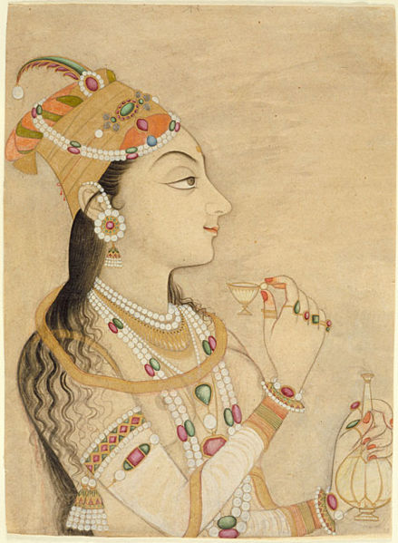
Source: Mani1
Nur Jahan
www.theanswer.co.za
See page 14

Slide 25
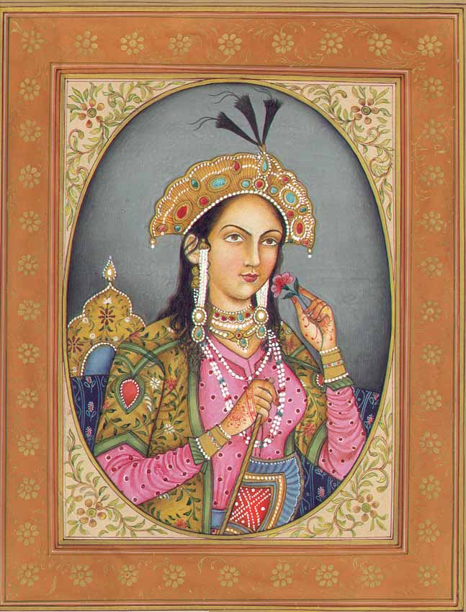
Source: www.exoticindiaart.com
Mumtaz Mahal
www.theanswer.co.za
See page 14

Slide 26
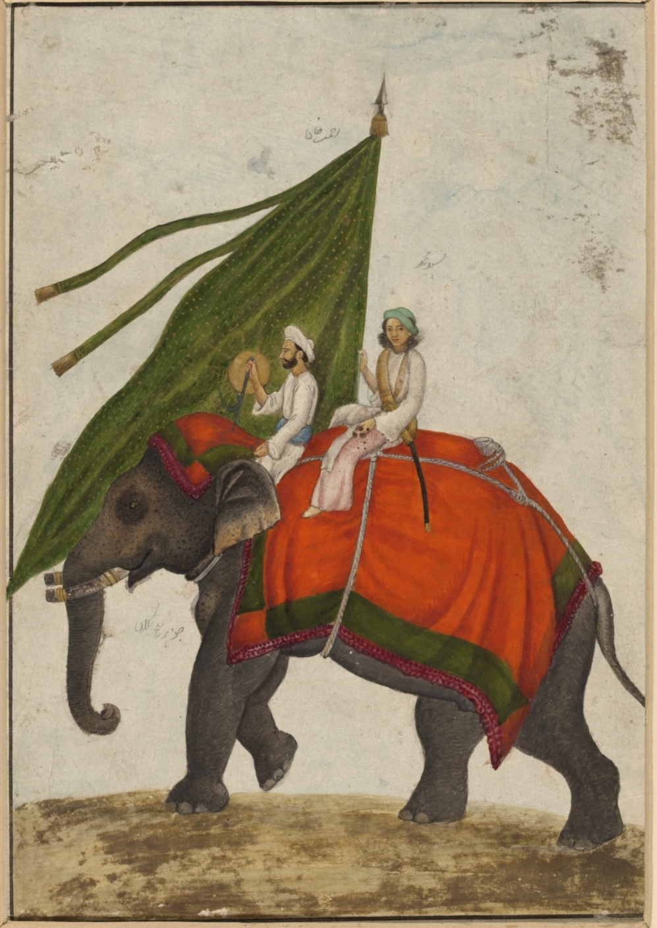
Source: Khan, Mazhar Ali
Artworks from the Mughal Empire were
sophisticated and relatively lifelike.
www.theanswer.co.za
See page 15

Slide 27
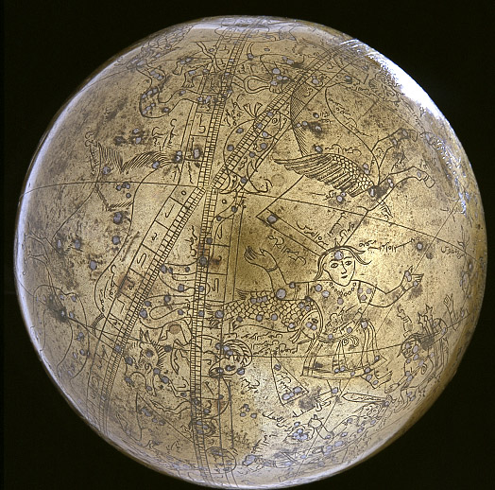
Source: Smithsonian Institution
Seamless celestial globe
www.theanswer.co.za
See page 16

Slide 28
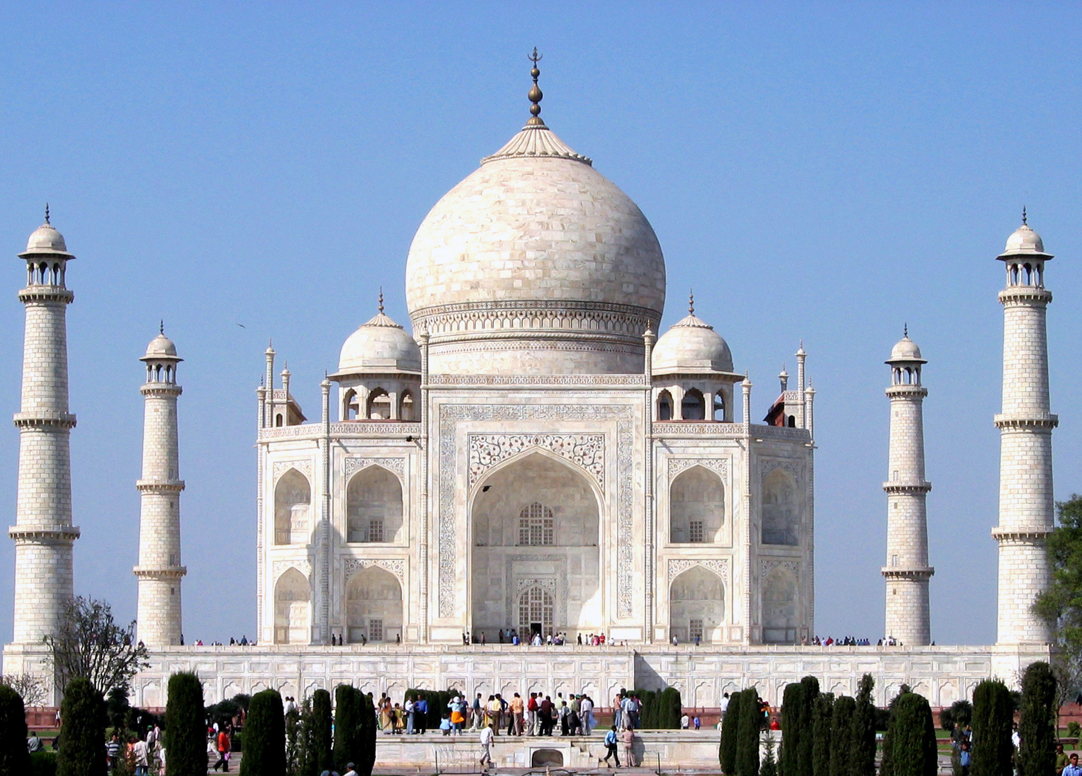
Source: Dhirad / J.A. Knudsen
The Taj Mahal is a refined white marble tomb.
www.theanswer.co.za
See page 16

Slide 29
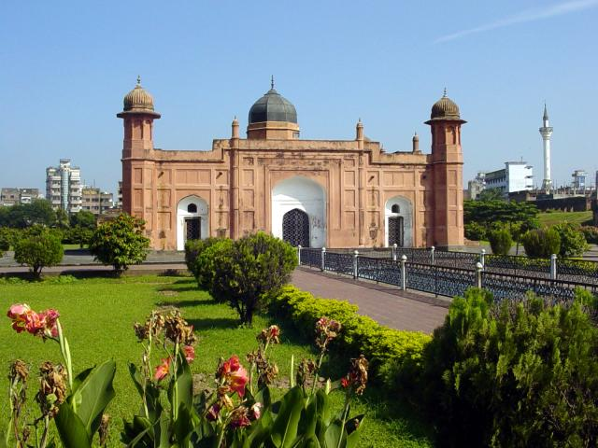
Source: Sfaisal2005
Lalbagh Fort is built of brick and plaster.
www.theanswer.co.za
See page 16

Slide 30
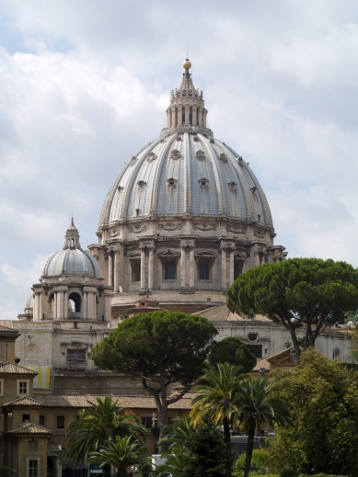
Source: Myrabella
The Vatican City in Rome was often the official residence of the Roman Catholic popes.
www.theanswer.co.za
See page 17

Slide 31
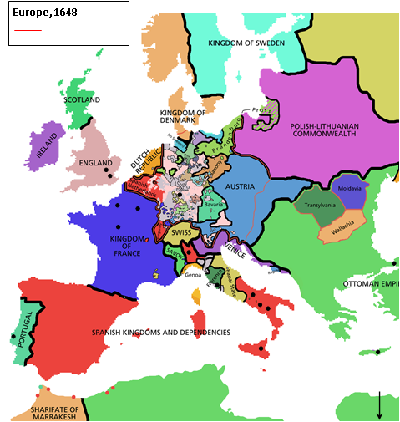
Holy Roman Empire
London
Hastings
Mainz
Paris
Paris
Chartres
Chartres
Orléans
Milan
Milan
Constantinople
Pisa
Siena
Rome
Naples
Lisbon
Sicily
Source: Rake
Cyprus
Jerusalem
Europe in 1648
www.theanswer.co.za
See page 17

Slide 32
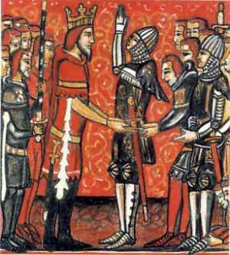
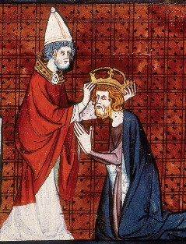
A knight making a pledge of
fealty to King Charlemagne
Pope Leo III of the Roman Catholic Church
crowned King Charlemagne as an emperor
in 800. This shows the power of the Roman Catholic Church in Europe.
www.theanswer.co.za
See page 19

Slide 33
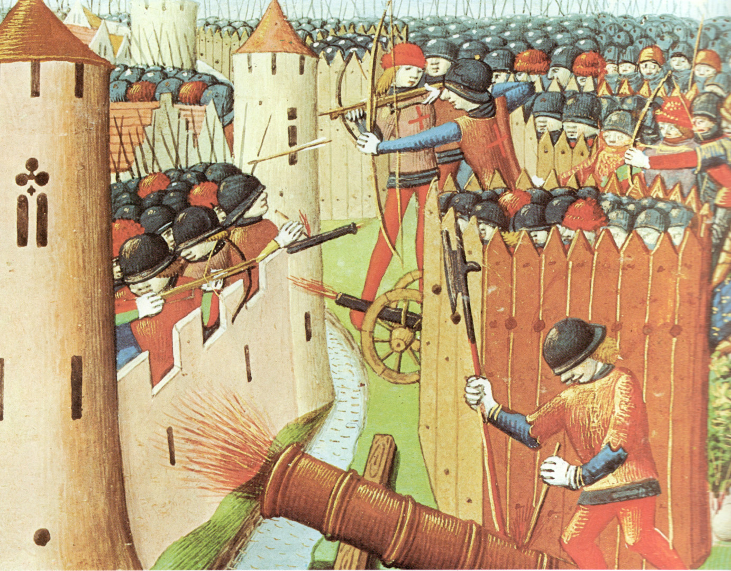
Source: Codex Manesse, Zurich
The Siege of Orléans in 1428
www.theanswer.co.za
See page 20

Slide 34
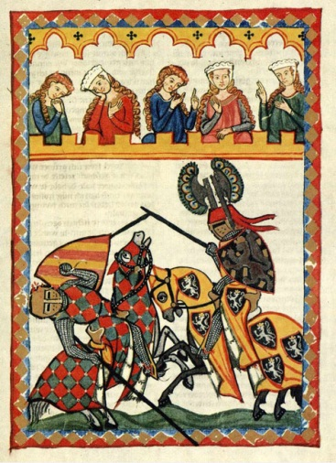
Source: Vigiles de Charles VII / Dake
A painting from the early 1300s showing knights in combat and noble women watching them
www.theanswer.co.za
See page 20

Slide 35
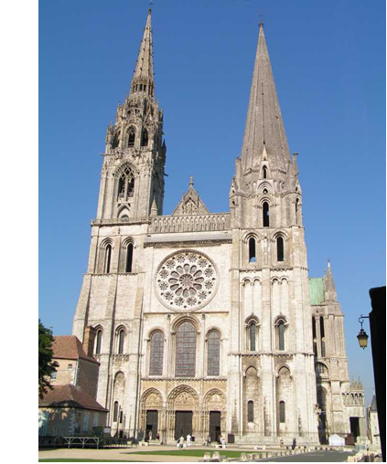
Source: Roby
Chartres Cathedral is a Medieval cathedral built in the Gothic style.
The advanced architecture of this building allowed it to have large stained-glass windows.
www.theanswer.co.za
See page 20

Slide 36
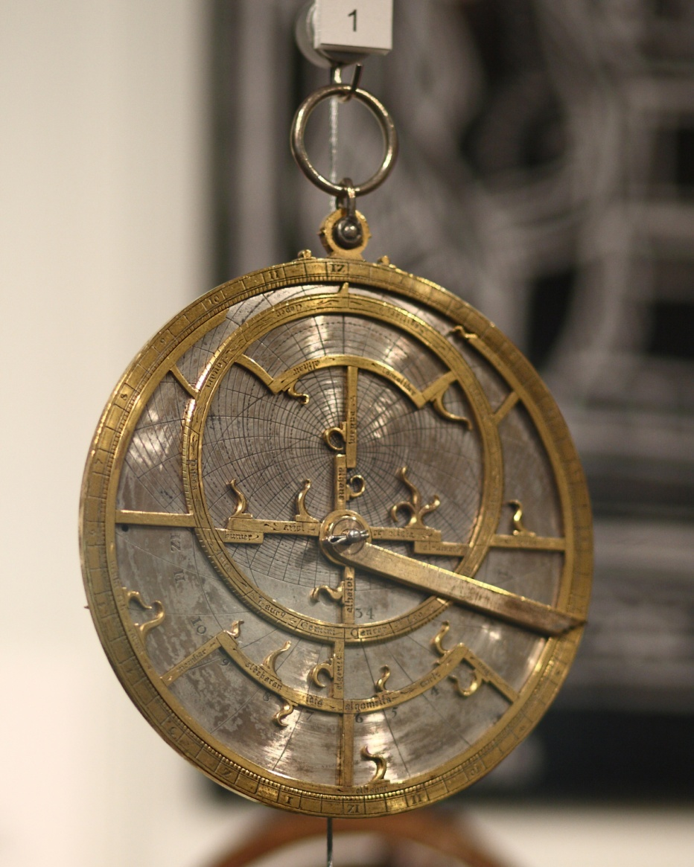
Source: Sage Ross
An astrolabe from the workshop of
Jean Fusoris in Paris circa 1400
www.theanswer.co.za
See page 21

Slide 37
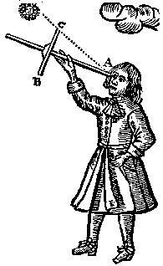
Source: Jljmt
The cross-staff (Jacob's staff) being used
www.theanswer.co.za
See page 21

Slide 38
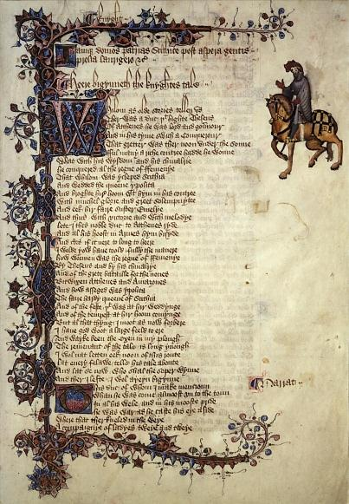
Source: University of Arizona Library Special Collections
The Ellesmere Manuscript of Chaucer's Canterbury Tales:
this is the first page of ‘The Knight's Tale’.
www.theanswer.co.za
See page 21

Slide 39
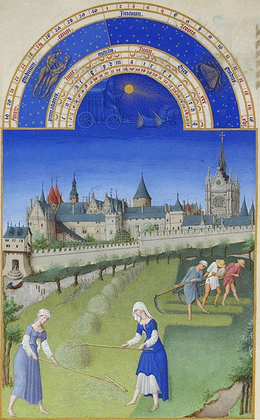
A page from The Very Rich Hours of the Duke of Berry, June,
produced by the Limbourg Brothers,
Barthélemy d'Eyck and Jean Colombe, 1412–1486
www.theanswer.co.za
See page 21

Slide 40
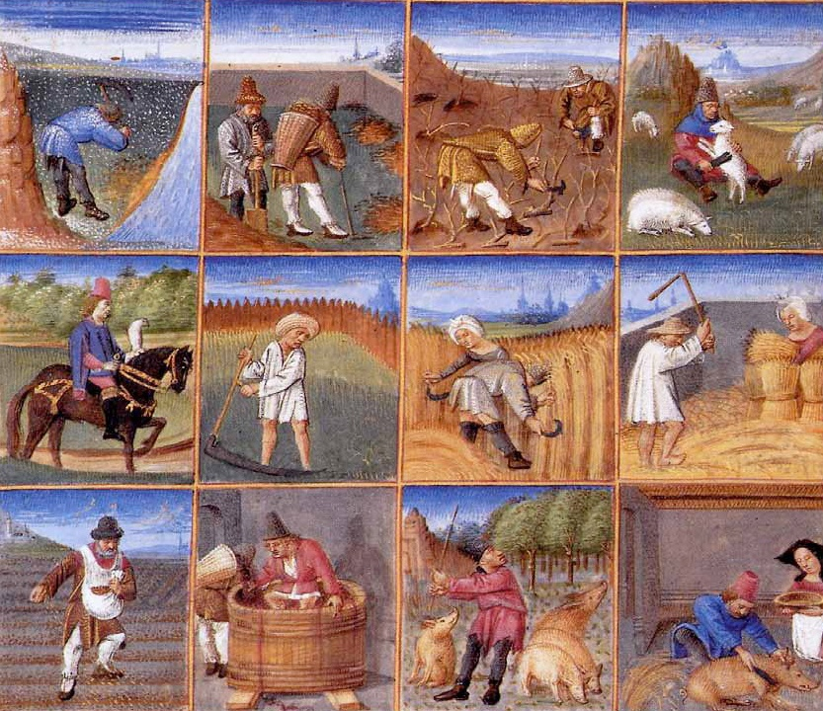
The lives of Medieval peasants during the 12 months of the year
by Pietro de' Crescenzi (circa 1230–1320)
www.theanswer.co.za
See page 22

Slide 41
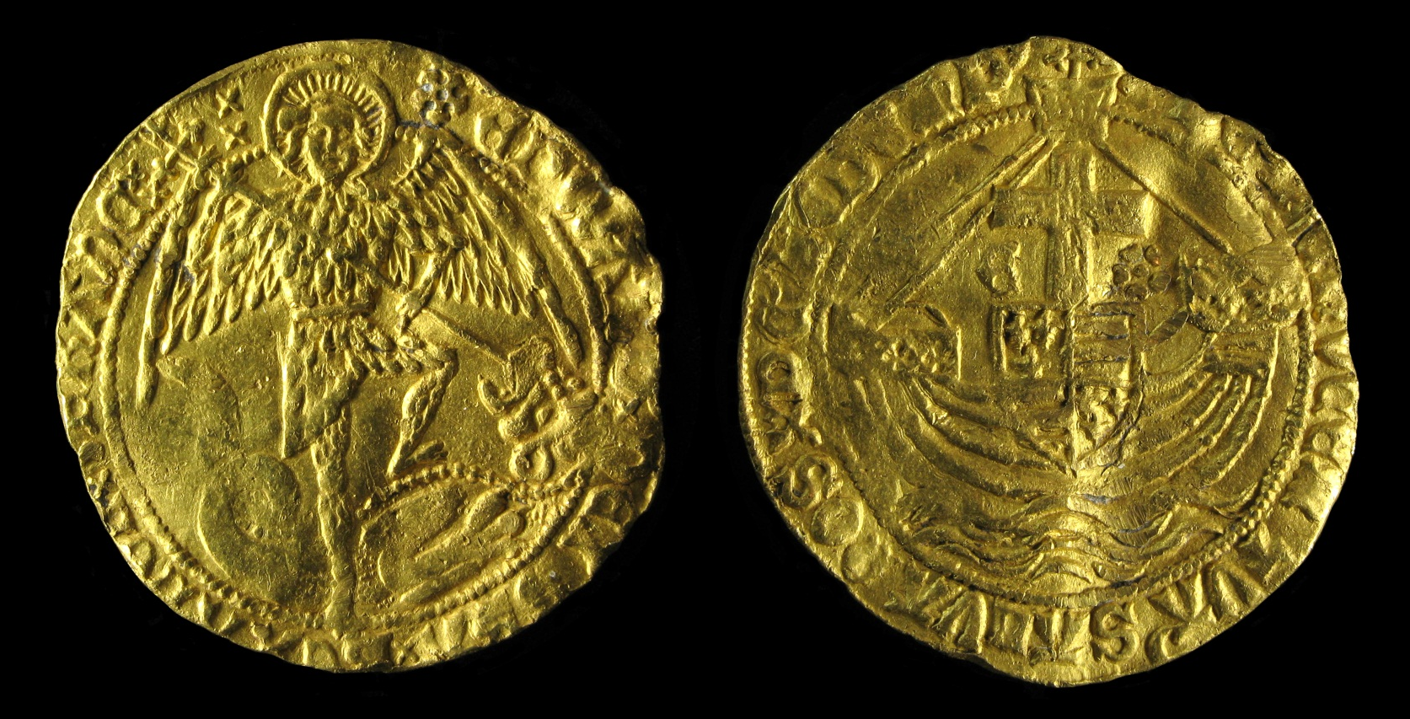
Source: Portable Antiquities Scheme
from London, England
The two sides of a coin from the reign of the English king, King Edward IV (1442–1483)
www.theanswer.co.za
See page 22

Slide 42
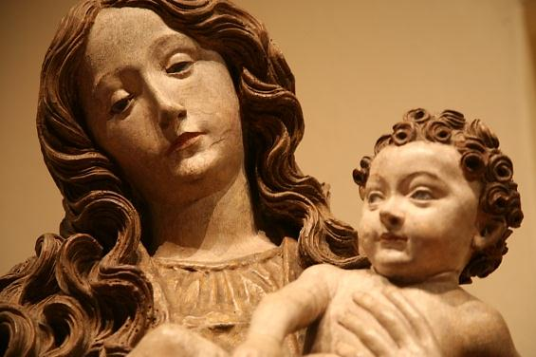
Source: vincent desjardins
A medieval carving of Mary and Jesus, important figures in the Christian religion
www.theanswer.co.za
See page 22

Slide 43
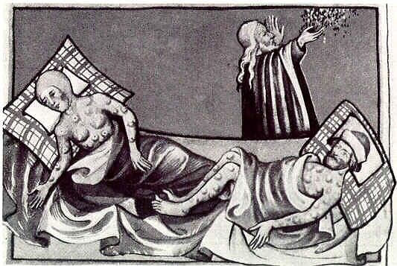
Source: Toggenburg Bible Dbenzhuser
A representation of the Black Death from 1411
www.theanswer.co.za
See page 23

Slide 44
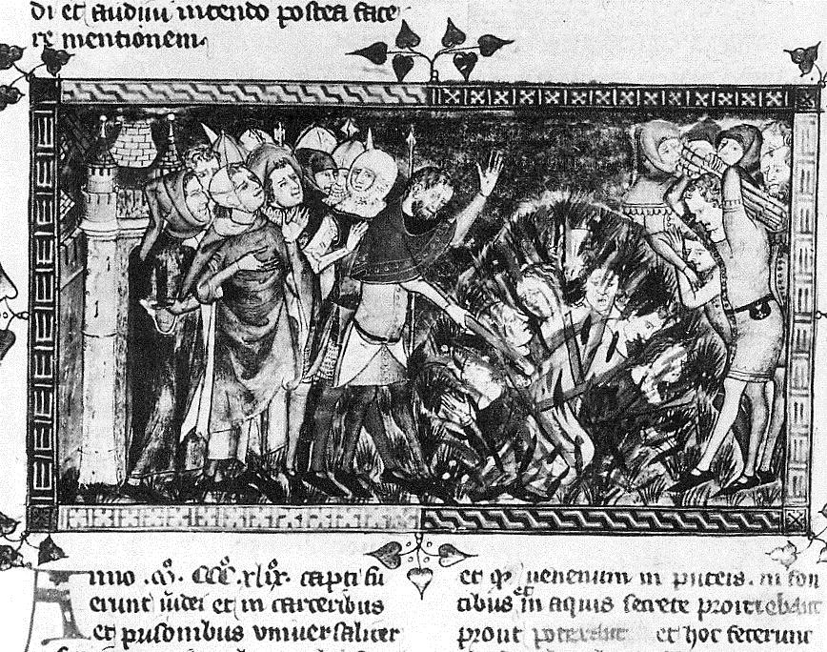
Burning of Jews during the Black Death epidemic, 1349
www.theanswer.co.za
See page 23

Slide 45
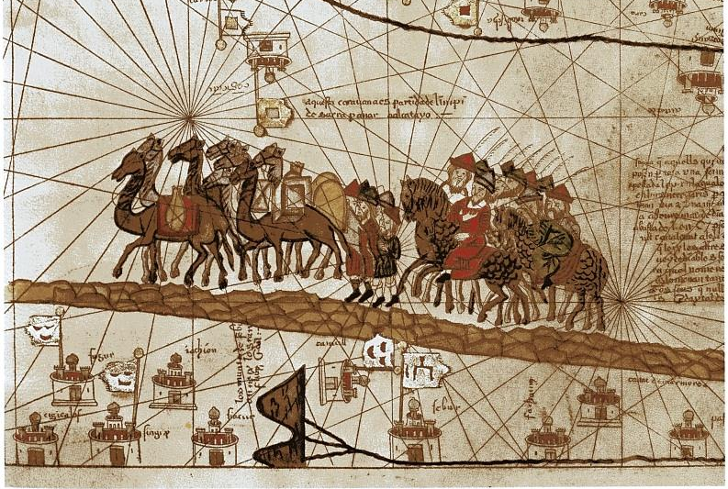
Source: Inconnu, Atlas Catalan
Marco Polo travelled through Asia from 1271 to 1295.
This drawing of his caravan was produced in 1375.
www.theanswer.co.za
See page 24

Slide 46
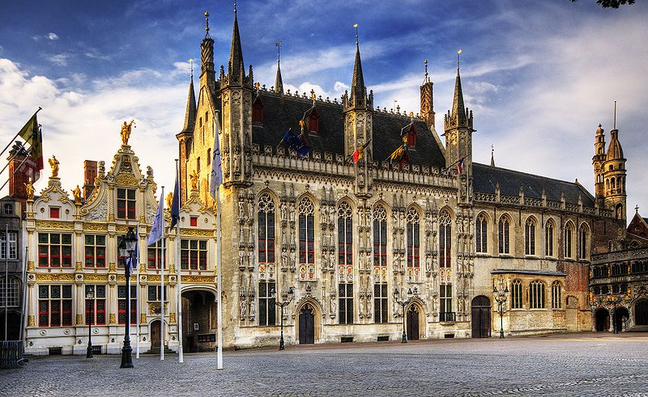
Source: Wolfgang Staudt
Bruges Town Hall is a sign of the wealth that was generated by the Medieval wool trade.
www.theanswer.co.za
See page 24

Slide 47
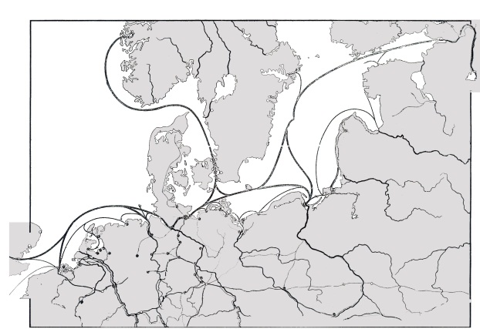
Bergen
Baltic
Sea
Russian
Steppes
Riga
Source: R Gassenhower
North
Sea
Copenhagen
Gdańsk
Amsterdam
Hamburg
London
Bruges
The Hanseatic League in 1400
www.theanswer.co.za
See page 25

Slide 48
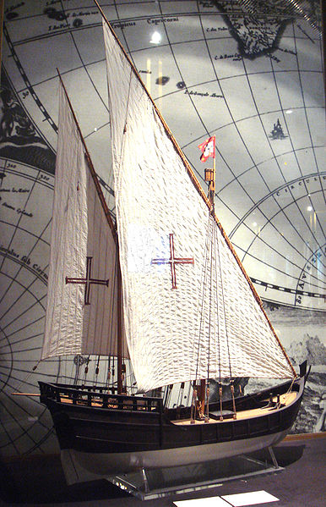
Source: PHGCOM
A recreation of a typical Portuguese caravel with lanteen (triangular) sails, developed around 1450.
The lanteen sails allowed the ship to tack (sail in a zig-zag pattern) into the wind.
www.theanswer.co.za
See page 25

Slide 49
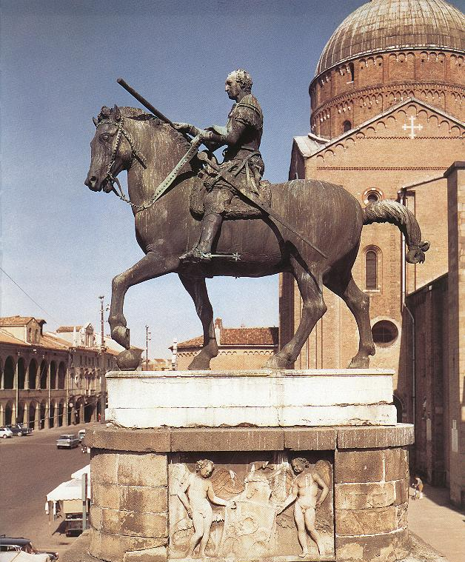
Source: Kjetil r
Donnatello's equestrian statue of Gattamelata was finished in 1450.
www.theanswer.co.za
See page 26

Slide 50

Source: Rico Heil / Silmaril
The head and torso of Michelangelo's David
www.theanswer.co.za
See page 26

Slide 51

Source: wartburg.edu
Leonardo da Vinci's Mona Lisa
www.theanswer.co.za
See page 26

Slide 52

Source: Hans Bug
Raphael's Sistine Madonna
www.theanswer.co.za
See page 26

Slide 53

Source: The Web Gallery of Art
Durer's 1502 painting called A Young Hare
www.theanswer.co.za
See page 27

Slide 54

Source: Web Gallery of Art (#7315)
Durer's 1513 engraving called Knight, Death and the Devil
www.theanswer.co.za
See page 27

Slide 55

Source: http://www.gabrielevanin.it/Bertini.jpg
An 1858 painting by Guiseppe Bertini:
Galileo Galilei showing the Doge of Venice how to use the telescope
www.theanswer.co.za
See page 27

Slide 56


Source: PDArt
Leonardo’s design
of a helicopter
Leonardo's sketch showing
the flight of a bird
www.theanswer.co.za
See page 27

Slide 57

Source: www.smu.edu
A page from Gutenberg's Bible
www.theanswer.co.za
See page 28

Slide 58

Source: Dietrich Bartel
A recreation of Columbus's three-masted flagship, the Santa Maria, which was a 21,4-metre long carrack. It was second-hand, not very fast, and originally meant for trade rather than exploration.
It was designed for the Mediterranean rather than as an ocean-going vessel.
www.theanswer.co.za
See page 28

Slide 59

www.theanswer.co.za

Slide 60

www.theanswer.co.za

Slide 61

Source: Dejvid
www.theanswer.co.za
See page 29

Slide 62

Source: Georgio
www.theanswer.co.za
See page 30

Slide 63

www.theanswer.co.za
See page 31

Slide 64

Source: EurAstro Mission to Mali Olybrius
www.theanswer.co.za
See page 31

Slide 65

Source: I Jungpionier
Emperor Akbar (left) visits Hindu Swami Haridas (right)
www.theanswer.co.za
See page 31

Slide 66

Source: Robert Tytler Charles Shepherd
A photograph of Emperor Bahadur Shah II that was taken in 1858 while he was awaiting trial by the British
www.theanswer.co.za
See page 32

Slide 67

The Very Rich Hours of the Duke of Berry, March, produced by the
Limbourg Brothers, Barthélemy d'Eyck and Jean Colombe, 1412–1486
www.theanswer.co.za
See page 32

